Slide 1
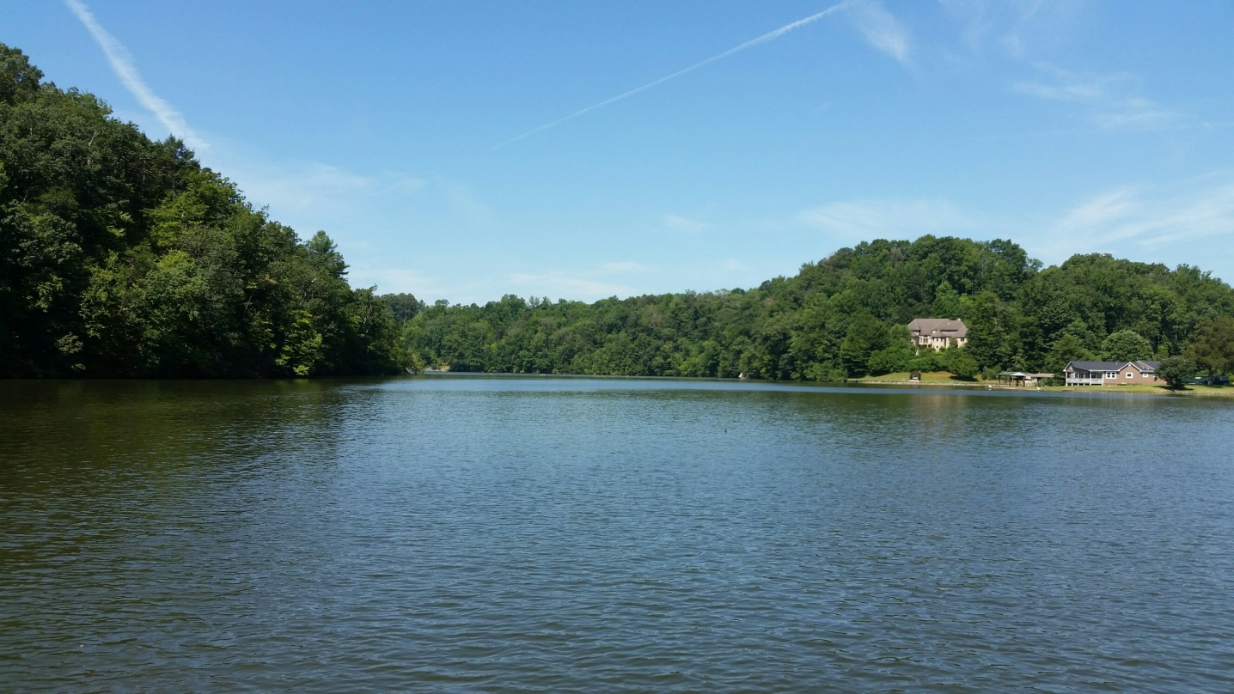
Blackwater Fill-in and Debris
Presentation to:
TLAC Board of Directors
13 February 2024

Slide 2
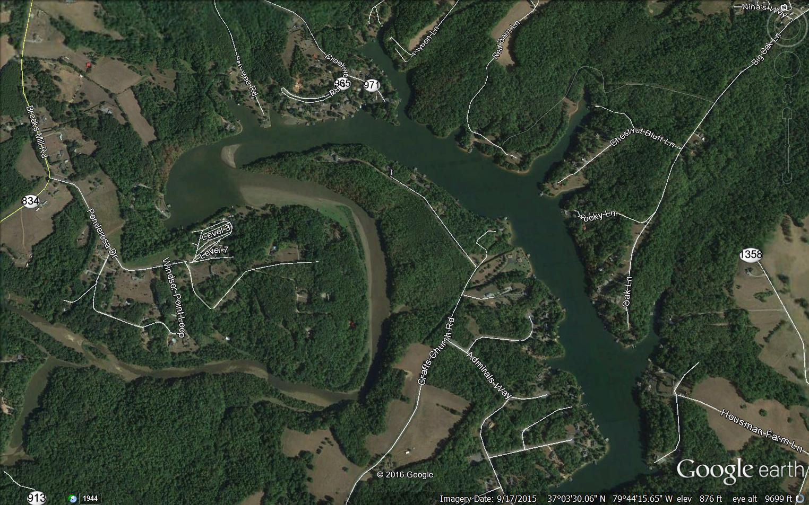
Dock out of water
New Lake Development
B-50/51??
North
Plattus Castle
B-49
Fill-in
Cooper Point
B-48
Docks & piers out of water
Ponderosa
Campground
Fill-in location directly across from the Ponderosa Campground and heading past marker B-49. Water level when picture was taken (Sep 2015) was 791.8 Ft (3.2 Ft below “Full Pond” of 795 Ft).
B-46

Slide 3
Blackwater Fill-in problem
Fill-in has accumulated across from the Ponderosa Campground in the main Blackwater channel both above and below marker B-49 oftentimes prevents Boaters / Fishermen from entering or leaving the Campground and Lake Front Properties. It has now fully accumulated downstream, preventing any boat traffic at low water levels.
At full pond, a serious safety issue with Boaters looking directly into the afternoon sun run into the fill-in oftentimes at a high rate of speed.
On 5 August 2017, another serious safety event occurred when a Smith Mountain Lake (SML) Fire Boat could not reach the Ponderosa Campground to assist in fighting a fire directly above the campground.
Above B49 Fill-in greatly reduced House Values with potential of Ponderosa closing. Below B-49 the same results are starting and will happen!
Fill–in affects Fish Spawning.
Other areas on the lake at Gills Creek and Bay Roc Marina have similar fill-in issues.

Slide 4
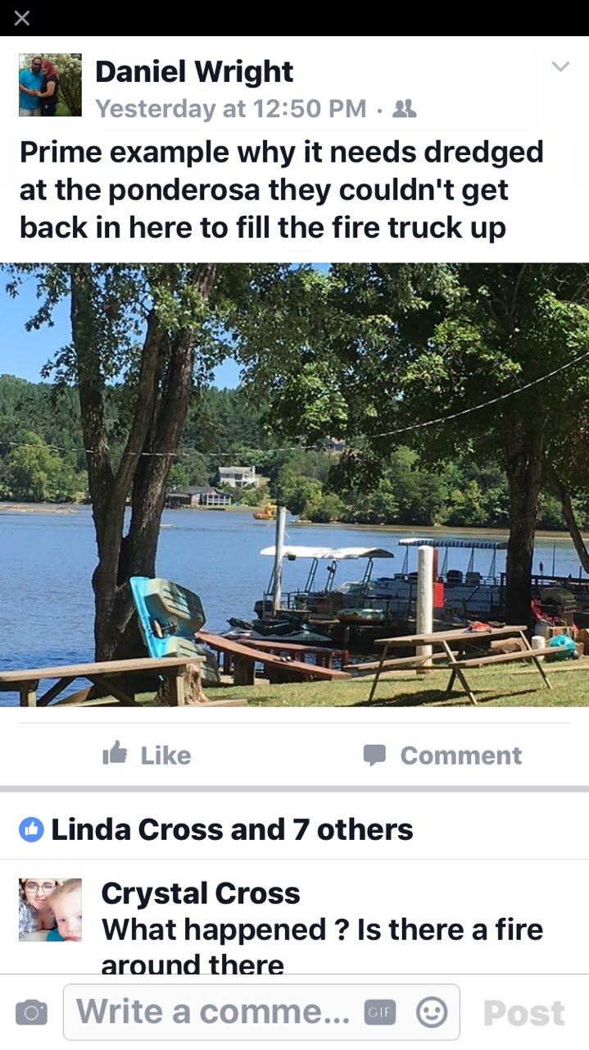
Cooper Point
Fire Boat

Slide 5
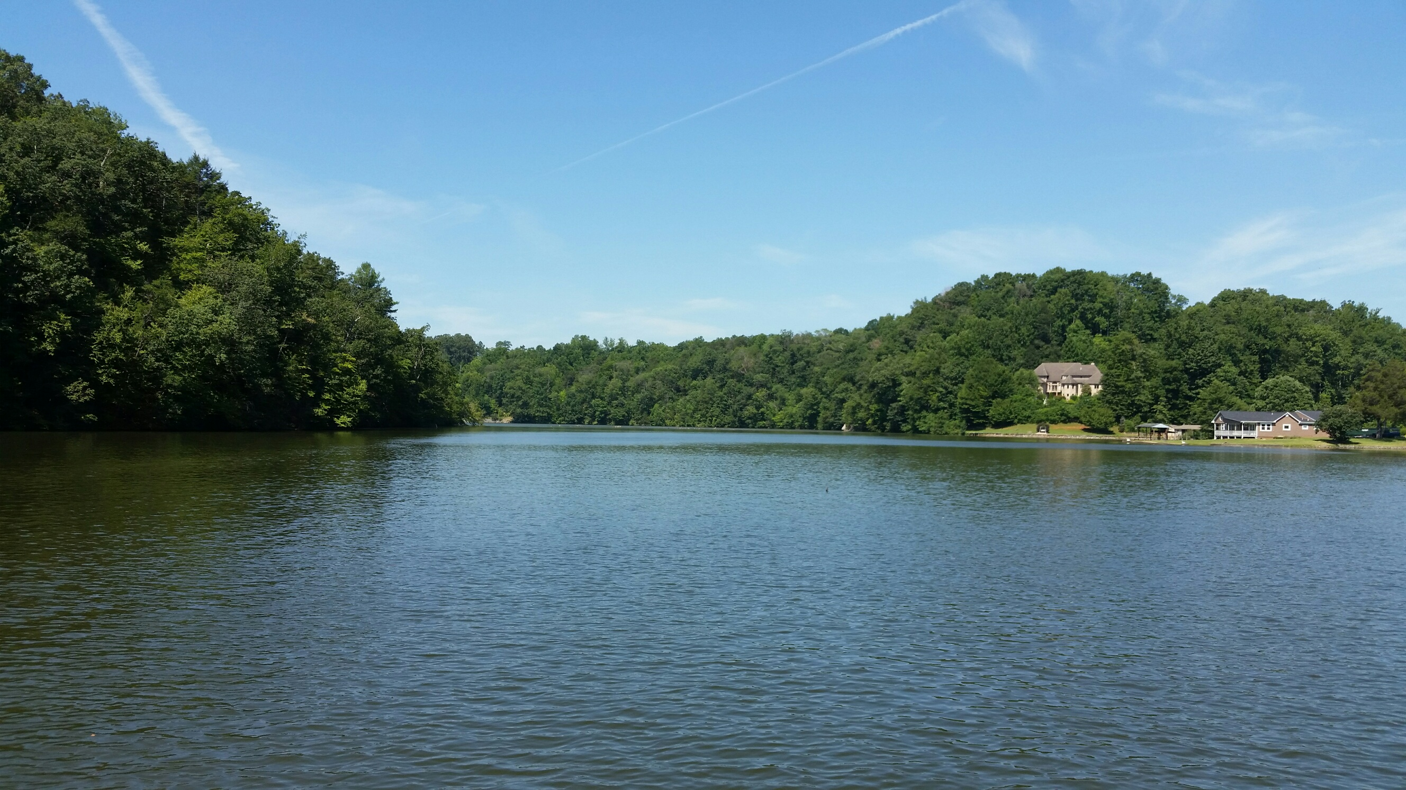
Cooper Point
Plattus Castle
Fill-in area
Photo heading West directly towards Fill-in (Ponderosa Campground around bend to the left). Photo taken at almost Full Pond (23 July 2016) at 794.6 Ft

Slide 6
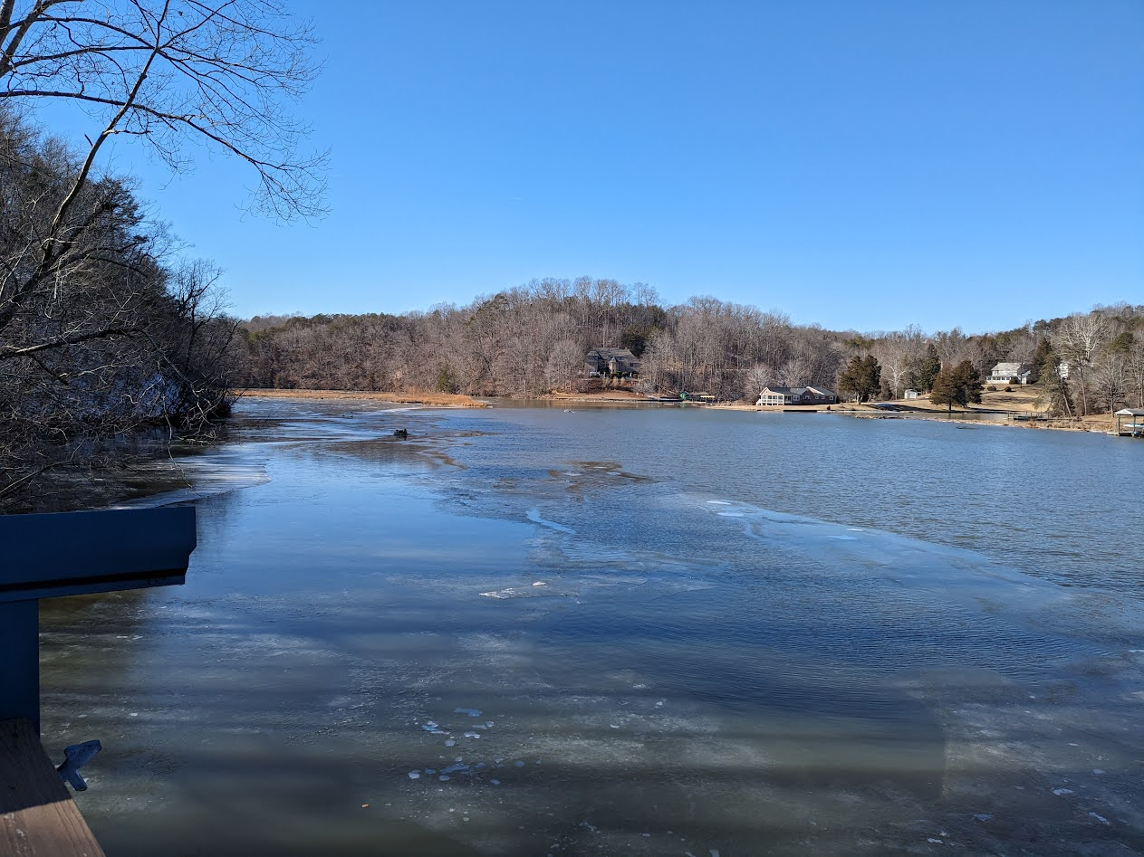
Cooper Point
Plattus Castle
Log
Picture taken Sunday 21 Jan 2024 with water level at 794.6 ft

Slide 7
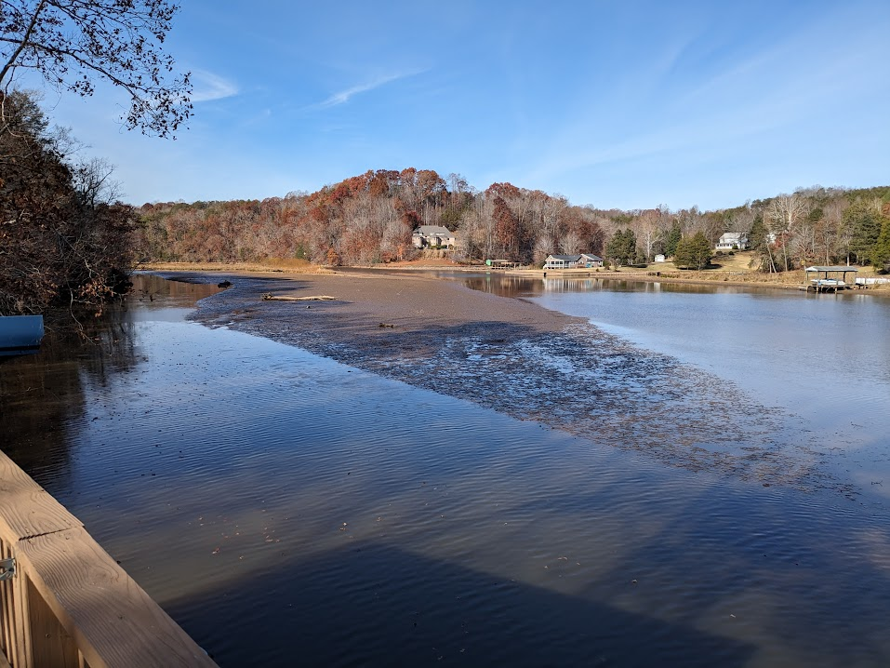
Plattus Castle
Cooper Point
Log
Water Level 792ft
15 Nov 2023

Slide 8
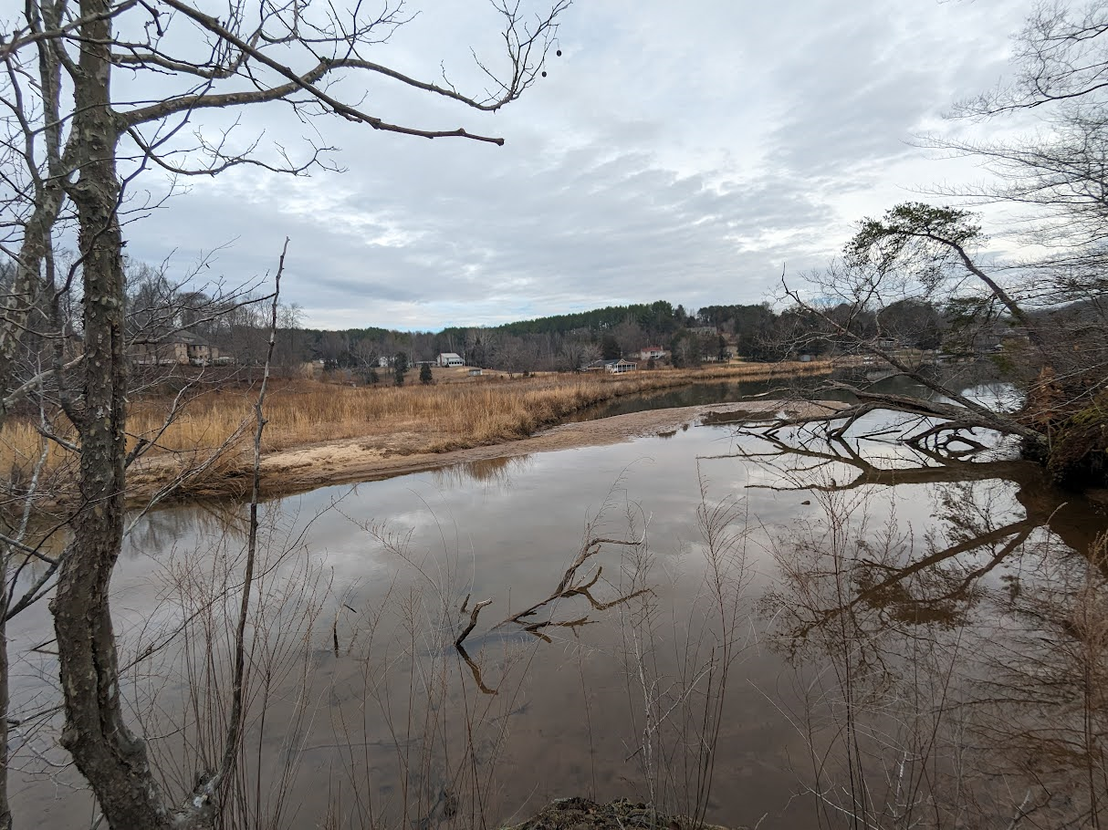
Plattus Castle
Picture taken from Cooper Point Friday 9 February 2024 with water level at 794.2 ft

Slide 9
Dock out of water
New Lake Development
B-50/51??
North
Plattus Castle
B-49
Fill-in
Cooper Point
B-48
Docks & piers out of water
Ponderosa
Campground
Fill-in location directly across from the Ponderosa Campground and heading past marker B-49. Water level when picture was taken (Sep 2015) was 791.8 Ft (3.2 Ft below “Full Pond” of 795 Ft).
B-46

Slide 10
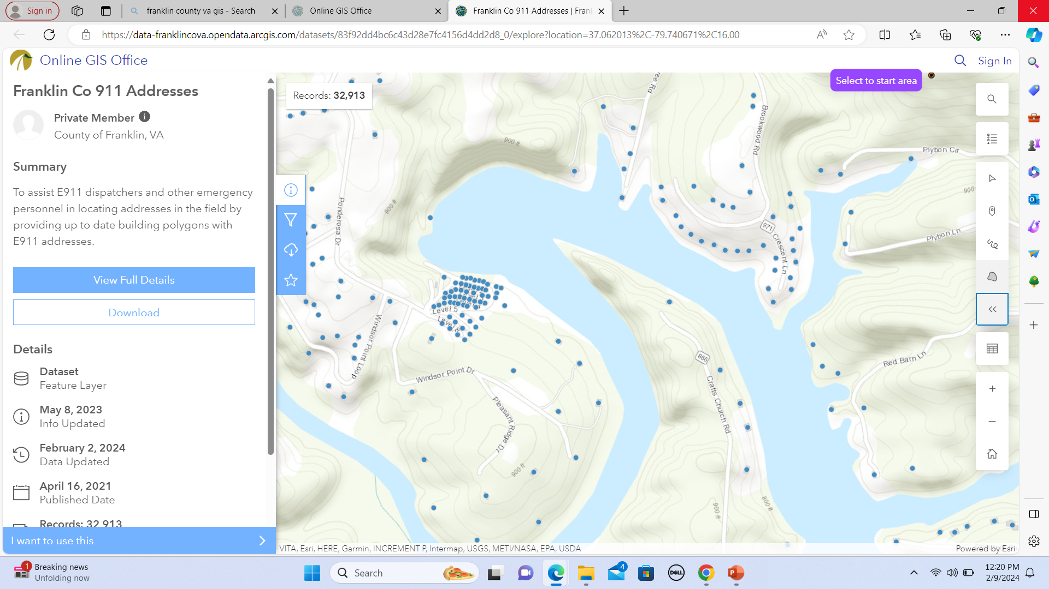
Plattus Castle
Fill-in
New Houses and Docks
B49
Ponderosa Campground
Note:
Fill-in past B49
B48

Slide 11
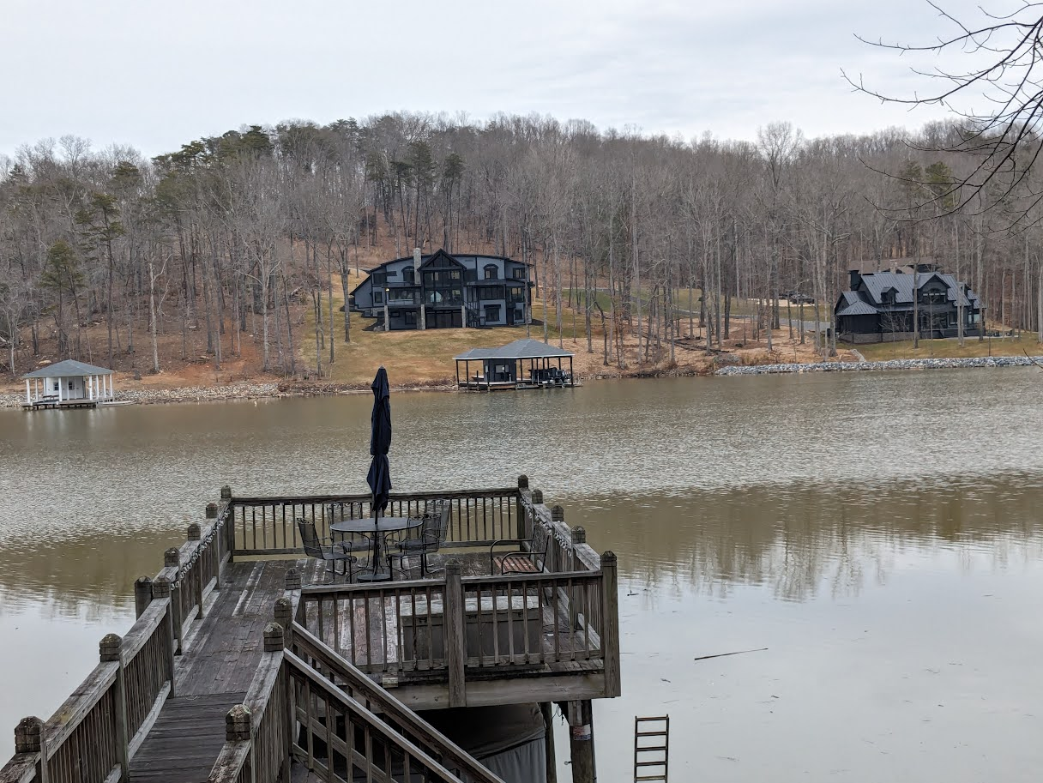
New Houses and Docks just built!!

Slide 12
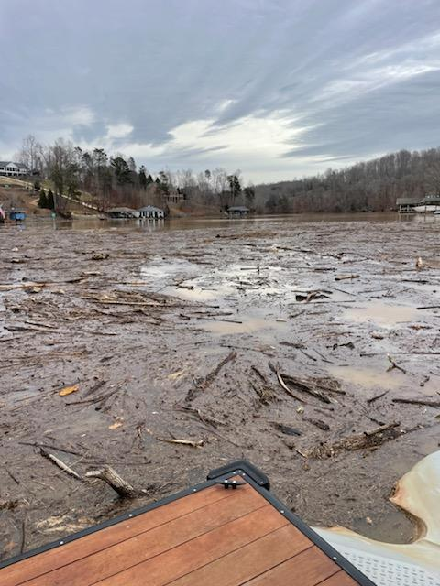
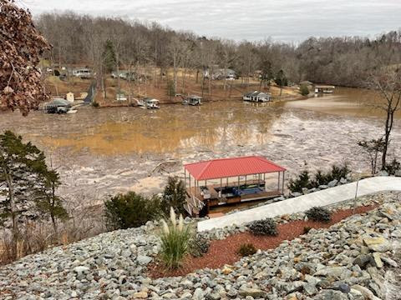
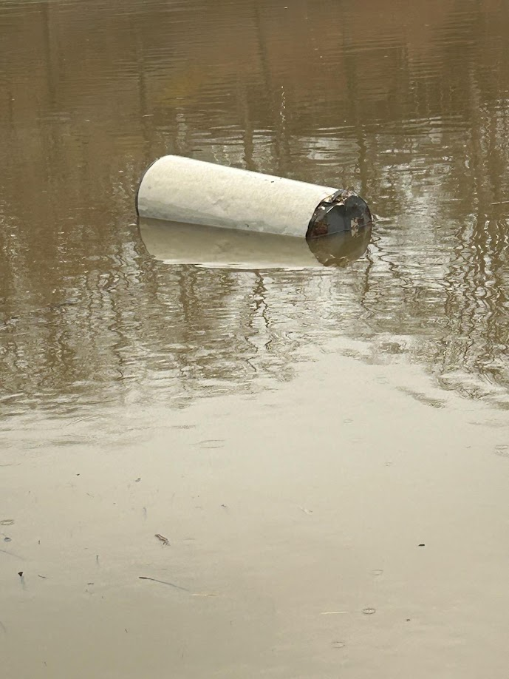
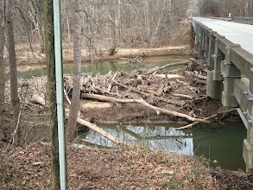
Blackwater Debris Problem
12 Jan 2024
B46
B45
12 Jan 2024
Rt 834 Bridge
Water Heater
10 Feb 2024
9 Feb 2024

Slide 13
What can be done?
Set aside a certain amount of funds for cleaning up (i.e., Dredging) this type of problem in future Appalachian, County and State budgets.
Determine if Grants or other funding sources are available to help offset these costs. We actually had funding available but lost land for a“de-watering basin”.
Local and State Officials should consider imposing soil barrier requirements on logging operations just as builders and other soil-disturbing businesses are currently required to do.
Consider barrier to catch fill-in and debris (As shown at Rt 834 bridge or by Ponderosa Channel)
Consider a “Win-Win” proposal with “Targeted Dredging”. Highlights of this approach would allow but not be limited to:
Continued boat access to SML by keeping targeted areas open
Helps prevent current dangerous situations
Only allowed in known areas of continual fill-in areas
Would allow up to 250 cu yds (or more vice current 25 cu yds) without the extensive testing and paperwork as is currently required
Affordable with current dredging companies on the lake

Slide 14
What can be done (Continued)
Helps keep Campground open and retain Home Owners’ property values plus current County, State, and Federal tax income (real estate, PP, sales) stream:
    22 Lake Property Owners on the lake severely affected between Campground and the B-49
    4 Existing and 6 brand new Property Owners soon to be affected.
    Campground has 49 yearly renters with trailers (plus 7 monthly trailer rentals) that pay yearly Personal Property (PP) taxes on those trailers.
For AEP, ACOE and DEQ shows a willingness to work with local businesses and property owners to solve a very hard problem. Note: As briefed to TLAC on 14 Feb 2017 I feel the Fill-in cleanup is AEP’s responsibility per SMP as part of their FERC license (see Backup Charts).
Keep SML’s as 100s year or more.
Reach out to Lake Lure in North Carolina concerning their Fill-in and Debris plan.
Other approaches??

Slide 15
Final thoughts
“Based upon the results of the studies related to Debris management, Appalachian does not believe that debris diversion or collection devices are justified. While Appalachian is not proposing the implementation of these devices as part of this management plan at this time, it is recognized that as conditions change, practices that may not be feasible today, may become feasible in the future.”
Fill-in area
Fill-in area
(Taken from AEP Debris Management Plan, Page 7, Paragraph 2, Section 3.2)

Slide 16
Bottom Line : We have to do something because if we do nothing, this is what will continue!!
Can You Please Help Us!!!

Slide 17
Back-up Slides

Slide 18
Background
(Presented at 14 Feb 2017 Tri-County Lake Association Mtg)
Linda Overstreet and I have consulted with Delegate Charles Poindexter and Mr. Steve Sandy (Director, Franklin County Planning and Community Development) concerning this fill-in problem. As recommended by Delegate Poindexter, we met with Mr. Neil Holthouser (AEP).
Mr. Holthouser agreed that the fill-in should be removed and contacted Mr. Chris Powell (U.S. Army Corp of Engineers), who indicated that removal of this fill-in to improve navigation above marker B-49 was possible pending approval of a joint application. Mr. Holthouser provided the joint application forms and asked if the Ponderosa and/or others would be willing to serve as the applicant.
Both Linda and I responded to Mr. Holthouser that we were not in a financial position to serve as applicants and cited rationale and paragraphs from the Shoreline Management Plan (SMP) as to why we felt this was totally AEP’s responsibility to clean up the fill-in and fund accordingly.
In the next few charts we will indicate our rationale for why AEP should be responsible for this cleanup. We will also indicate Mr. Holthouser’s response, which indicated strong disagreement with our premise and that they continue to have no plans to dredge in this area.

Slide 19
In our 31 Aug 2016 email to Mr. Holthouser (AEP), we referenced specific paragraphs from the Shoreline Management Plan (SMP) updated 30 January 2014. The following are the specific paragraphs referenced with our rationale:
Para 1.3 Goals and Objectives “The overall goal for the SMP is to provide guidance for fulfilling license responsibility and obligations for the Project including protecting and enhancing the Project’s environmental, scenic and recreational values”;
Para 1.3.4 “Enhancing recreational opportunities by considering boating densities and navigation and maximizing available use of the project waters by the public”;
Our Rationale: Not removing the fill-in mentioned above is greatly affecting the ability of the Public using Ponderosa Campground to safely navigate to or from (and at times, the ability to not even get past the fill-in altogether) and enjoy the rest of the project’s waters and the lake’s recreational interests. This condition does not meet the above paragraphs for “fulfilling license responsibility and obligation for .…. Protecting and enhancing …… recreational values …..and navigation ….”. Additionally, although not highlighted as part of our 31 Aug 2016 email, the scenic value of the lake is greatly diminished by the looks of debris caught by the fill-in (as shown on the opening title view graph)

Slide 20
and Para 1.3.8 “Striving for a balance that supports local economic interests yet protects environmental and recreational resources and that allows the public to enjoy these interests and resources.”
Our Rationale continued: Due to the lack of lake access, this situation is having a negative economic impact on the Ponderosa Campground, with future closure a real possibility. Closure of this Campground will also have a direct negative economic bearing on Franklin County, the State of Virginia and the Federal Government in the loss of various tax revenue.
Additional information (not part of our 31 Aug email):
    The Campground currently has 49 yearly renters with trailers that pay yearly Personal Property (PP) taxes on those trailers.
    Additionally, there are 7 monthly trailer rentals in which the Campground pays the yearly PP taxes on these trailers,
    along with the Campground paying yearly Property Real Estate taxes, Sales Tax, plus State and Federal Income taxes.
    Bottom line is it does add up!!
Also not mentioned in our 31 Aug email is this overall fill-in problem is also affecting the property values (and associated tax values) of the 22 property owners on the lake between the fill-in and the B-49 marker. Even at full pond, some owners can barely get their boats out to the main channel.
Notes:
See

Slide 21
Again, as mentioned in the previous chart concerning the potential of Ponderosa closing and the associated overall effect on property values, this condition does not meet Para 1.3.8 “Striving for a balance that supports local economic interests yet protects environmental and recreational resources and that allows the public to enjoy these interests and resources”.
Additionally, this filled-in area is also very dangerous for boaters on the downstream side of this filled-in area. With the pond at full or near full levels, boats traveling toward Ponderosa cannot see the debris on top of the fill-in (especially looking directly into the summer afternoon sun) and run directly into it, sometimes at high speed.
Also mentioned in the email to Mr. Holthouser was tile 14 of 24 of the SMP, which clearly shows the fill-in has occurred well within the Project’s boundary.

Slide 22
Potential Next Steps
As we pay a premium in taxes for the pleasure of living on the lake. Maybe a certain amount of funds for cleaning up this type of problem should be included in future Appalachian, County, and State budgets.
Determine if Grants or other funding sources are available which could be used to help offset these costs.
Local and State Officials should consider imposing soil barrier requirements on logging operations to help prevent silt from entering the Project just as builders and other soil-disturbing businesses are currently required to do.
Bite the Bullet and do the Dredging: (Local neighbor willing to fund large part)
On 5 December 2017, we met again with Neil Holthouser to determine the dredging application process. Neal provided names from AEP, VA DEQ, and the ACOE.
On 6 December 2017, we met with Steve Sandy (Franklin County) who, provided names from the Virginia Institute of Marine Science (VIMS) who could possibly collect and do the soil sampling.
Currently working with VIMS and DEQ to obtain contour maps and soil samples.
Note: This has been a very time-consuming and will be a costly project. Plan is to use Hydraulic Cutter Head Suction Dredging. Big problem is where to put the dredged material!!

Slide 23
Potential Next Steps (Continued)
Consider a “Win-Win” proposal with “Targeted Dredging.” Highlights of this approach would allow:
Continued boat access to SML by keeping targeted areas open
Helps prevent current dangerous situations
Only allowed in known areas of continual fill-in issues
Would allow up to 250 cu yds (or more vice current 25 cu yds) without the extensive testing and paperwork as is currently required
Affordable with current dredging companies on the lake
Helps retain homeowners property values
Helps retain current County, State, and Federal tax income
For AEP, ACOE, and DEQ show a willingness to work with local businesses and property owners to solve a very hard problem
As indicated in the initial emails with Mr. Holtshouser, dredging is good (for AEP) in that it makes the “bathtub” bigger hence that more water capacity is obtained and the associated “good press and improved relations for AEP” in that they are willing to work with lake owners as opposed to what is currently heard comments such as “AEP could care less – it’s all about making money”
Other Approaches??

Slide 24
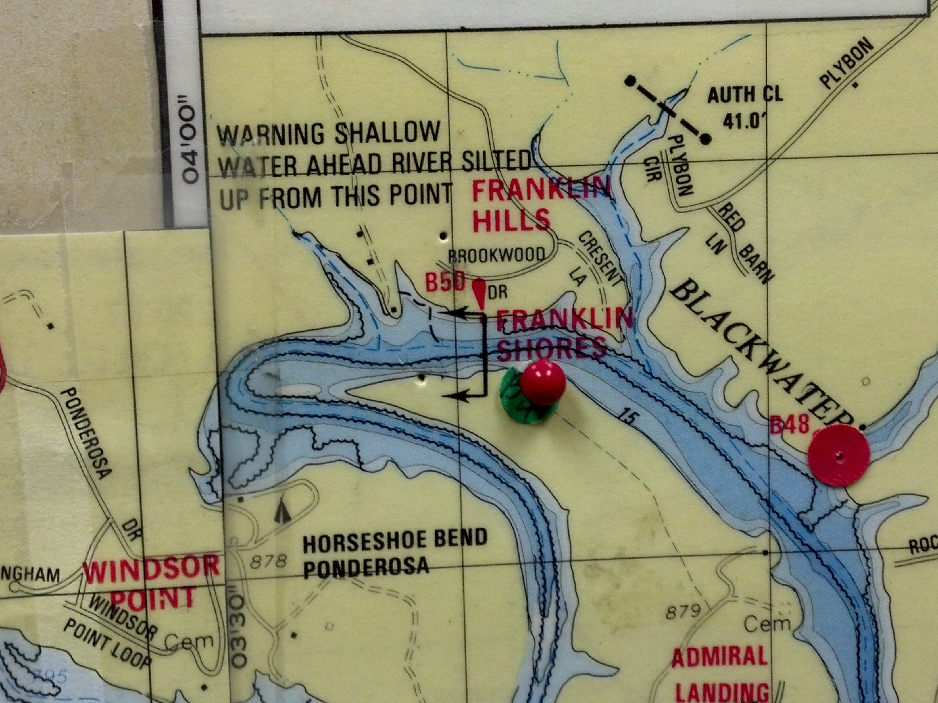
Map hanging in TLAC’s Office
7 Feb 2017

Slide 25
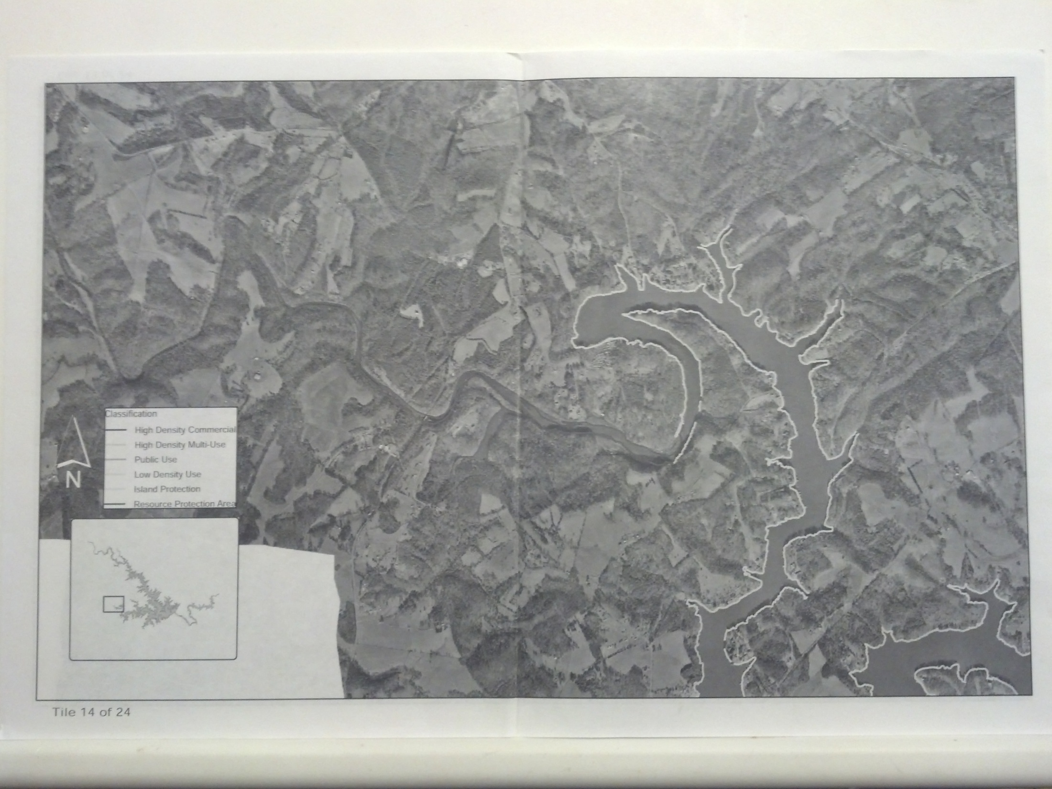
Tile 14 of SML Shoreline Management Plan (SMP) dated 30 January 2014
Fill-in area
Ponderosa Campground
End of SMP Project boundary

Slide 26
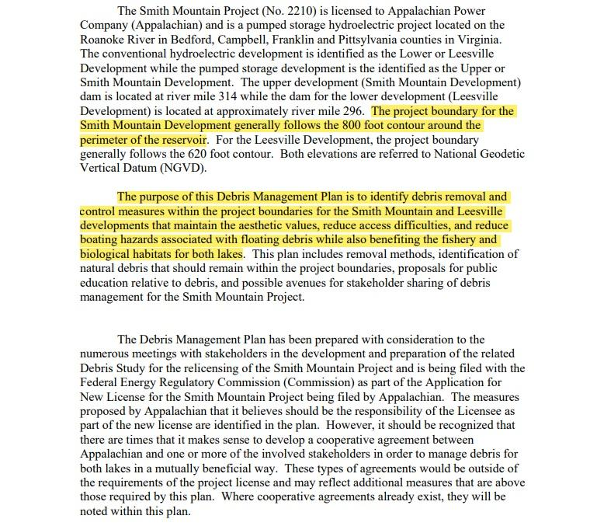
“Summary” Page 1 of the Debris Management Plan (FERC No. 2210) Dated July 2008

Slide 27
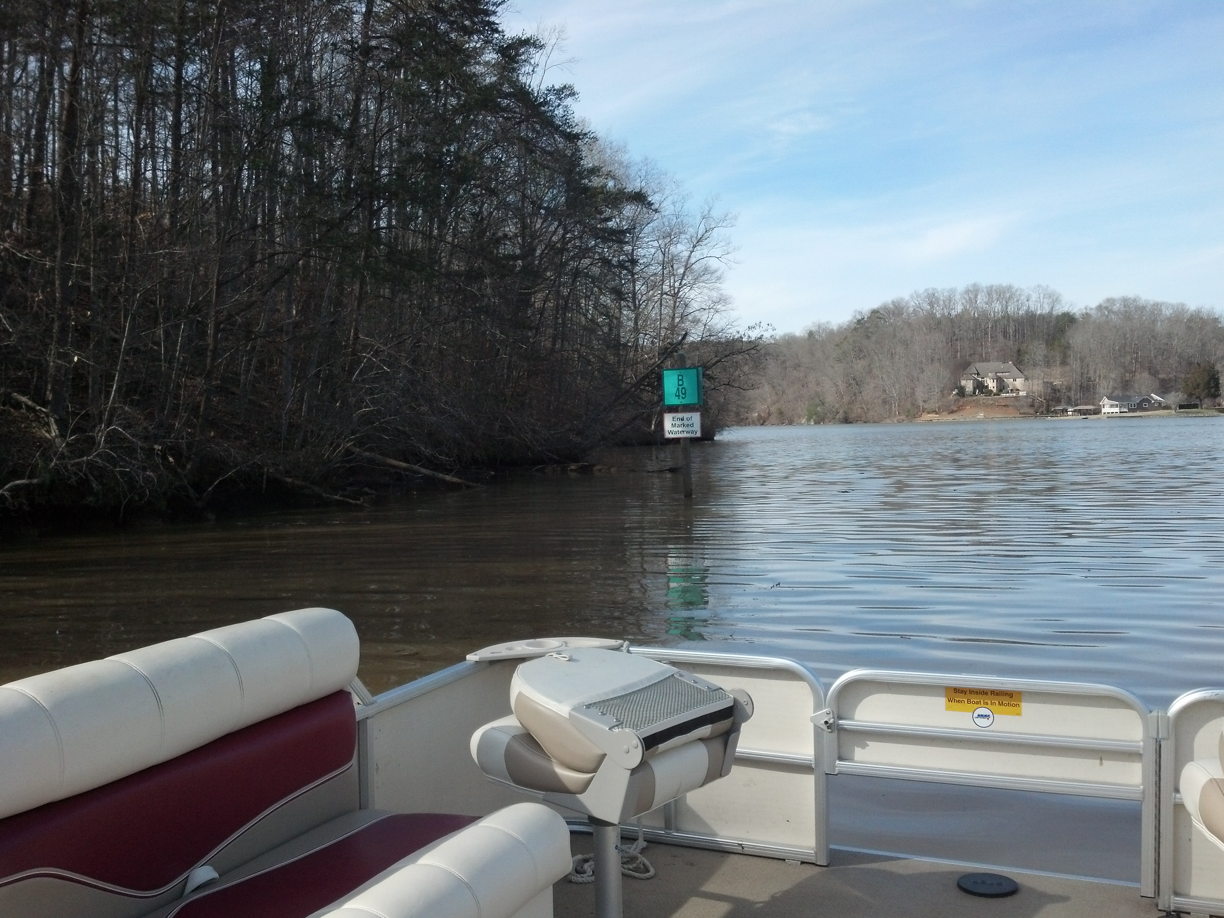

Slide 28
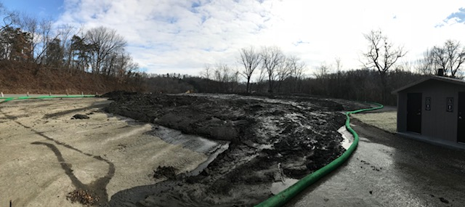
Sediment removed by AEP at Hardy Ford Public Boat Landing Ramp

Slide 29
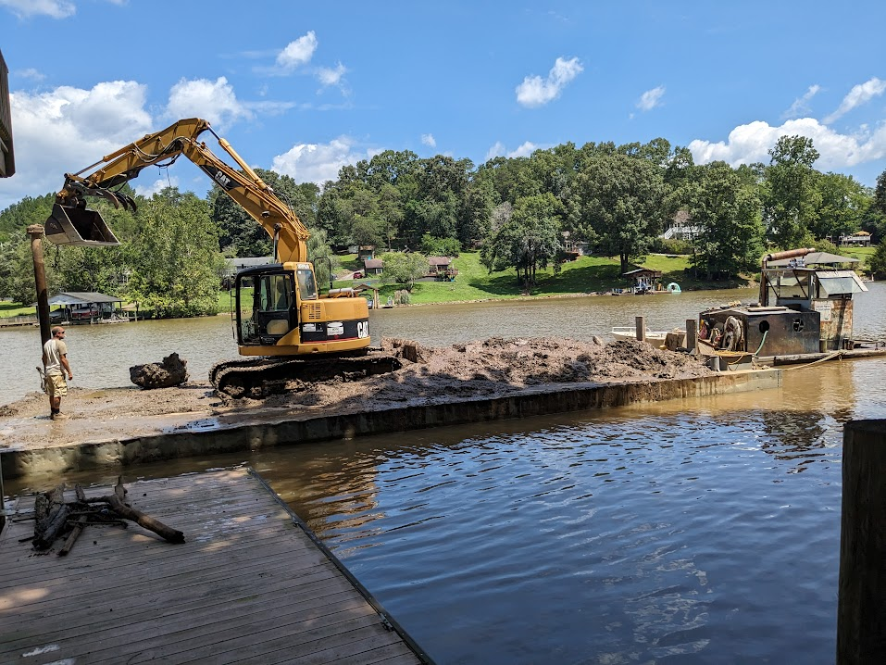
Dicky Dill dredging in front of Cooper Dock July 2023

